Slide 1
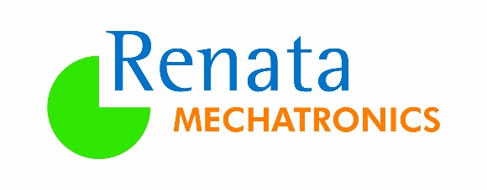
VALUE STREAM MAPPING
VSM Information :
Value-stream mapping also known as material- and information-flow mapping, is a lean-management method for analyzing the current state and designing a future state for the series of events that take a product or service from the beginning of the specific process until it reaches the customer. A value stream map is a visual tool that displays all critical steps in a specific process and easily quantifies the time and volume taken at each stage . Value stream maps show the flow of both materials and information as they progress through the process.
Whereas a value stream map represents a core business processes that adds value to a material product, a value chain diagram shows an overview of all activities within a company. Other business activities may be represented in "value stream diagrams" and/or other kinds of diagram that represent business processes that create and use business data.
Purpose :
“ The purpose of value-stream mapping is to identify and remove or reduce "waste" in value streams , thereby increasing the efficiency of a given value stream. Waste removal is intended to increase productivity by creating leaner operations which in turn make waste and quality problems easier to identify”

Slide 2
Types Of Wastes :
Faster-than-necessary Pace: creating too much of a good or service that damages production flow, quality, and productivity. Previously referred to as overproduction, and leads to storage and lead time waste.
Waiting: any time goods are not being transported or worked on.
Conveyance: the process by which goods are moved around. Previously referred to as transport, and includes double-handling and excessive movement.
Processing: an overly complex solution for a simple procedure. Previously referred to as inappropriate processing, and includes unsafe production. This typically leads to poor layout and communication, and unnecessary motion.
Excess Stock: an overabundance of inventory which results in greater lead times, increased difficulty identifying problems, and significant storage costs. Previously referred to as unnecessary inventory.
Unnecessary Motion: ergonomic waste that requires employees to use excess energy such as picking up objects, bending, or stretching. Previously referred to as unnecessary movements, and usually avoidable.
Correction Of Mistakes: any cost associated with defects or the resources required to correct them.

Slide 3
Customer’s Details :
Customer : | Valeo India Pvt. Ltd Pune
OEM : | Suzuki
Part Name : | Brush Holder
Raw Material : | PPS GF 40%
Grade & Colour : | Ryton R4 200
Annual Volumes : Ex Works Renata
Year | Locations : Valeo Pune/Mexico
Year 1 | 2020 | 600000
Year 2 | 2021 | 600000
Year 3 | 2022 | 600000
Year 4 | 2023 | 600000
Year 5 | 2024 | 600000
Year 6 | 2025 | 600000
Year 7 | 2026 | 600000

Slide 4
Actual Dispatch Vs Tentative Schedule Quantity :
Standard Takt Time From This Firm Schedules : 37.762 Sec/part
Actual Takt Time From Dispatched Qty : 37.951 Sec/part

